Slide 1

Welcome
Asian Engagement and Recruitment Core (ARC)
February Partner and Champion Meeting
February 26, 2021
F

Slide 2
Agenda
Welcome and AoURP Enrollment Status
Partner Spotlight
Special Spotlight Speaker (Hep B and OCA)
ARC Quarterly Event: Spring into Action
ARC Office Hour Schedules
ARC Scheduled Events for March
Reminder and Closing
F

Slide 3
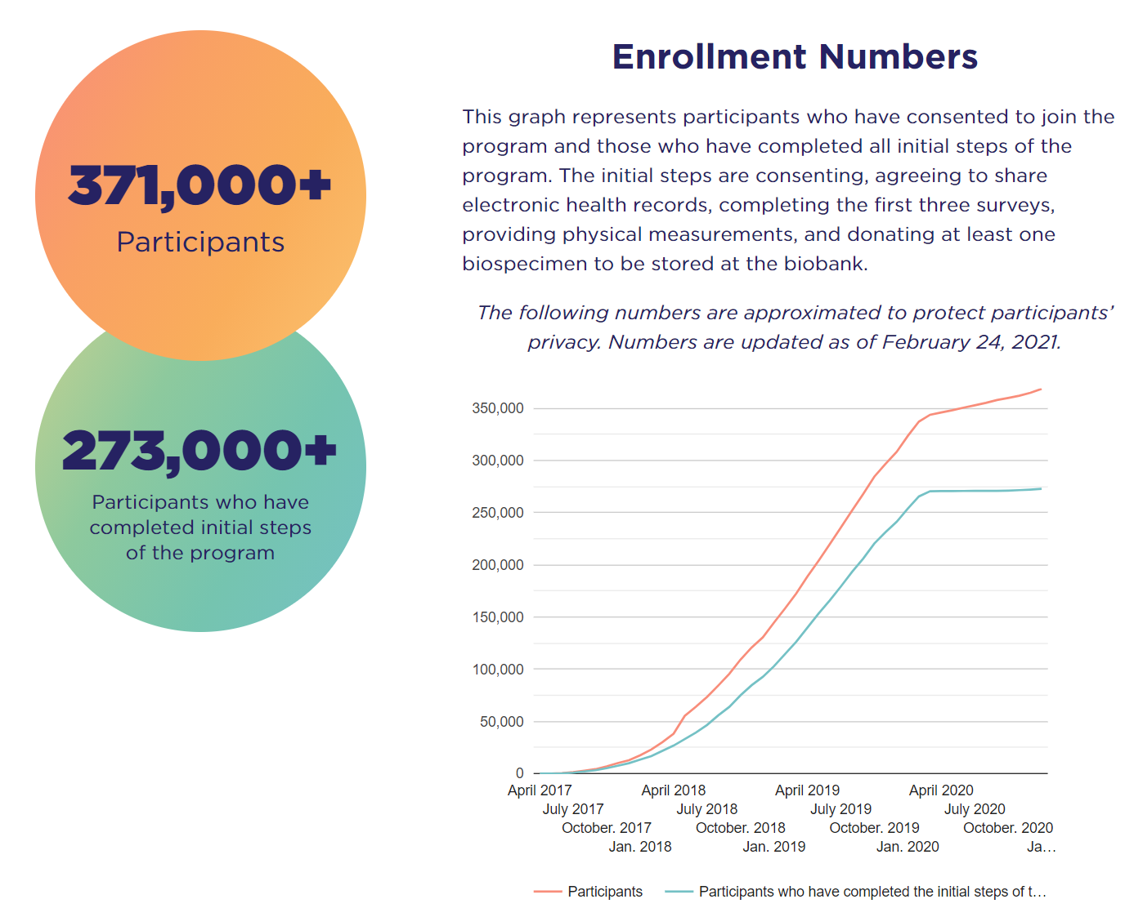
Welcome
~ 11,127 out of 273,462 (4.07%) Core Participants are AANHPI
S

Slide 4




Partner Spotlight
Administrative (PORT) and Social Media Activity (#allofusarc)
S

Slide 5

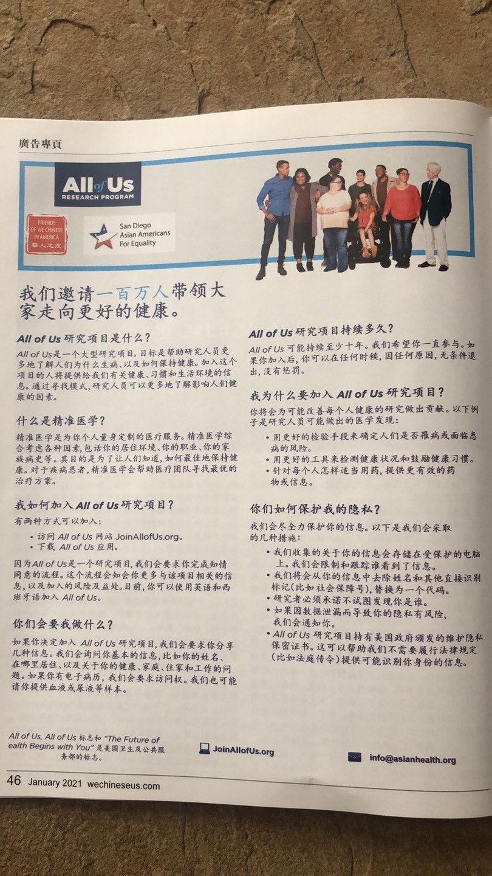
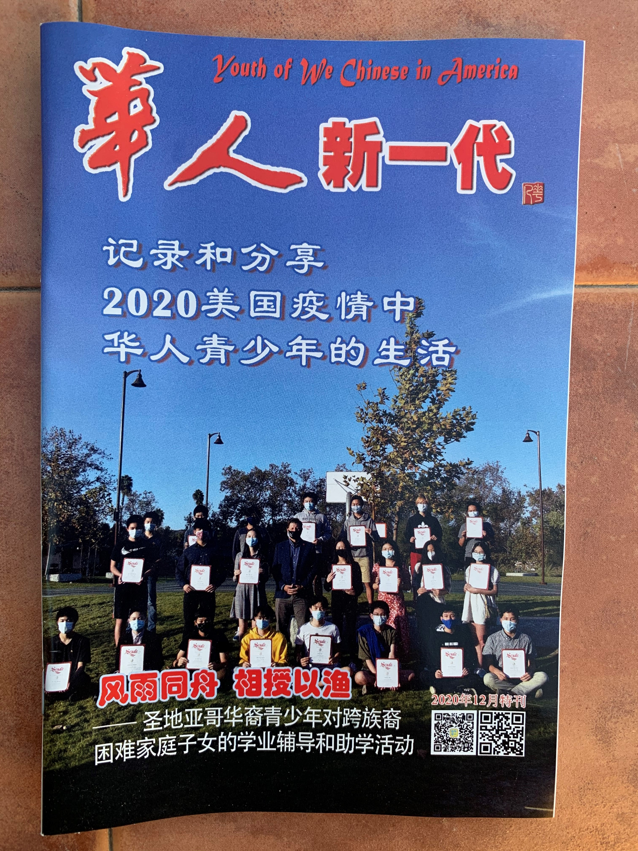
Partner Spotlight

Slide 6
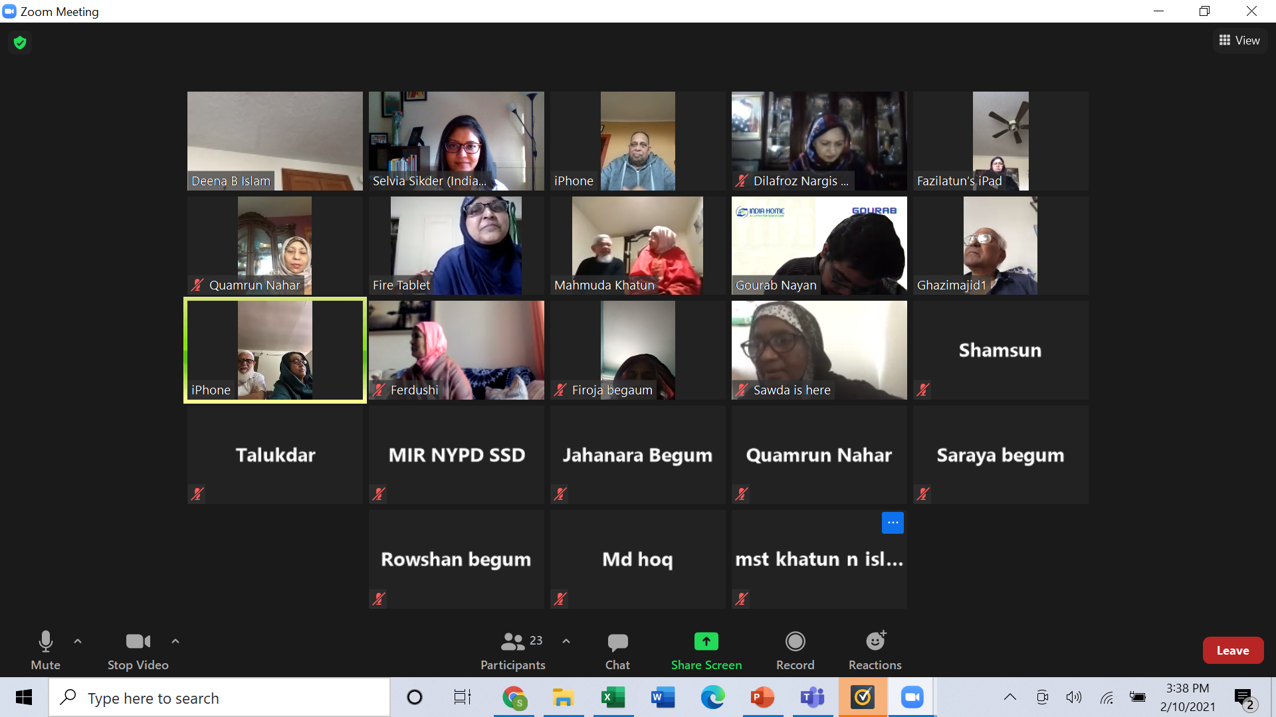
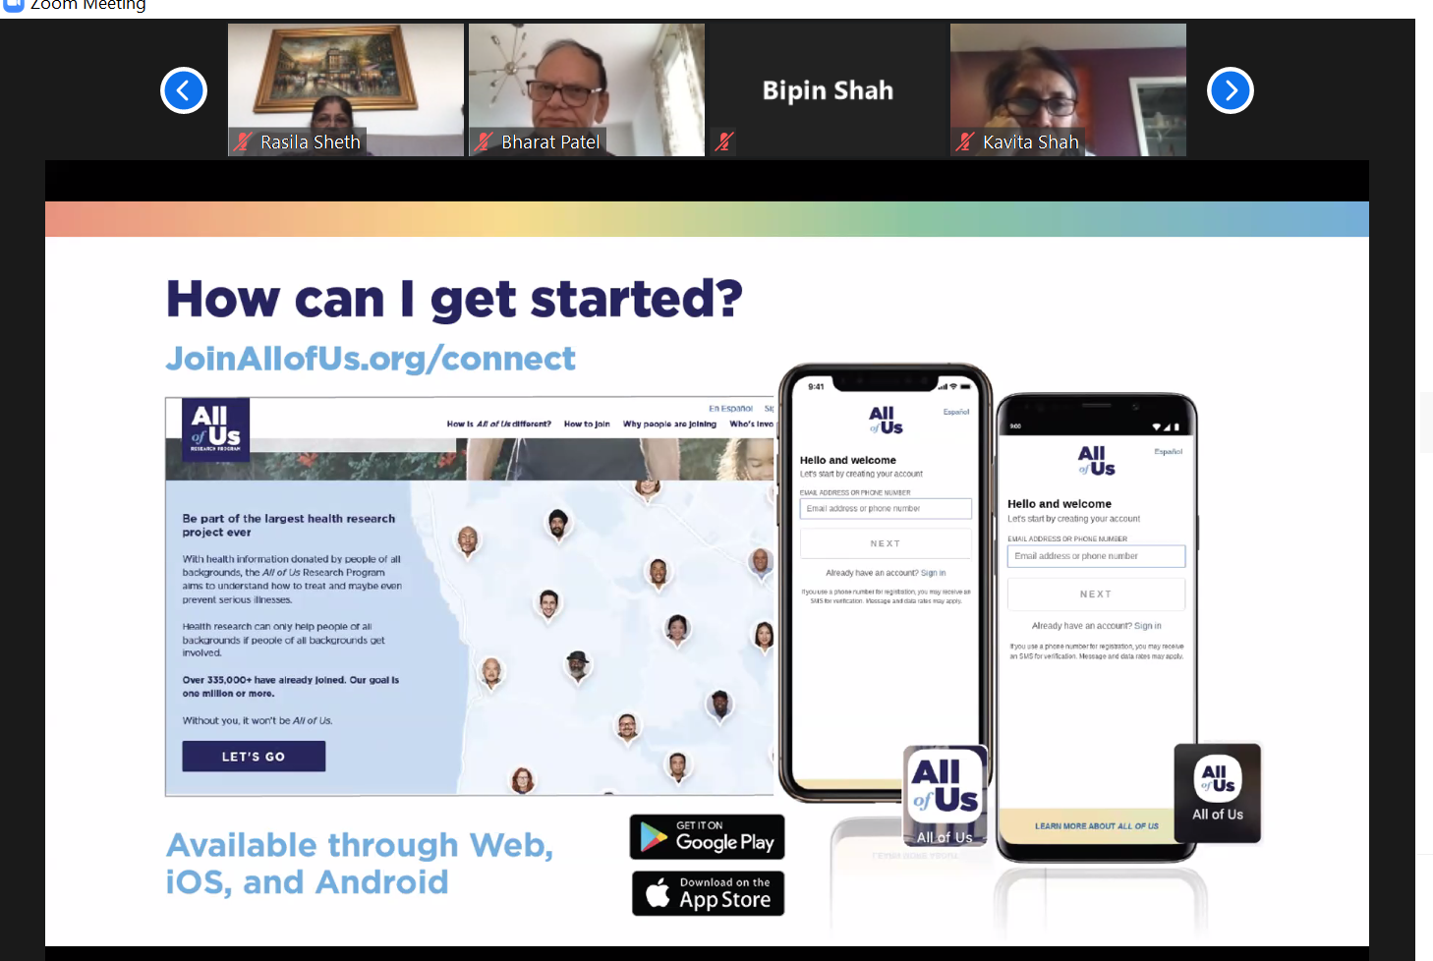
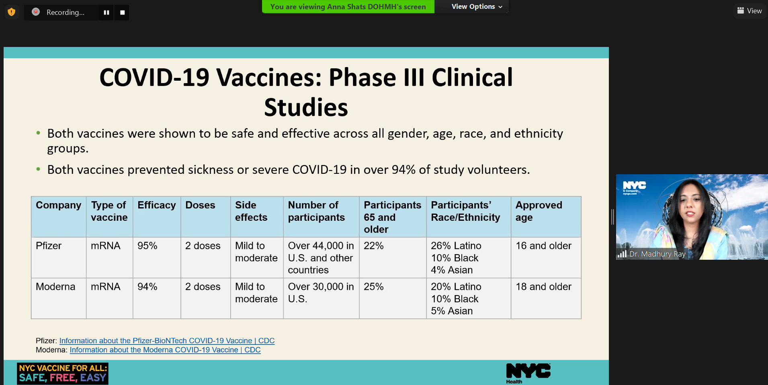
Partner Spotlight

Slide 7

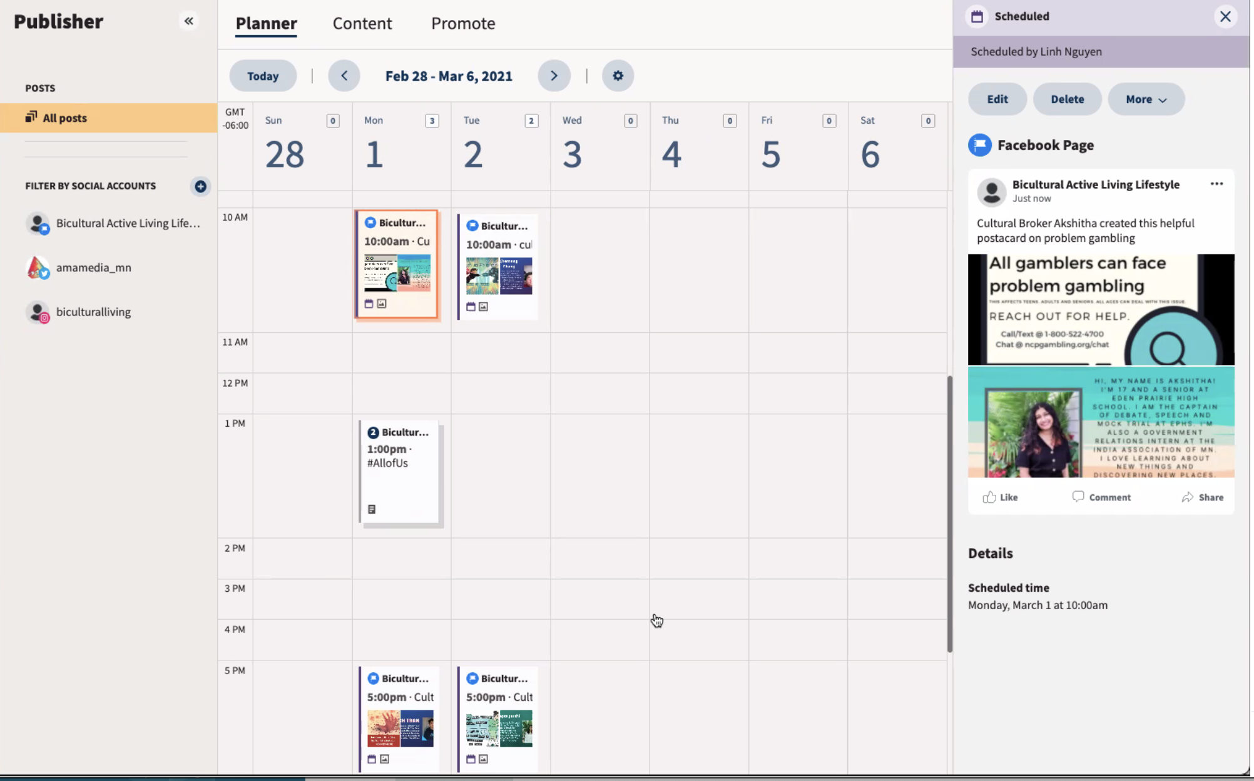
Partner Spotlight

Slide 8

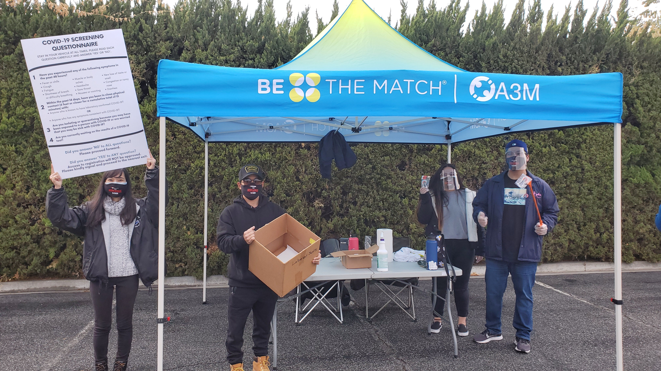
Partner Spotlight

Slide 9


Partner Spotlight

Slide 10


Special Spotlight Speaker
F

Slide 11
#AllofUsARCChat
Twitter Chat
Reflections & Overview
02.26.2021

Slide 12

Planning & Promotion
Origin of idea
Guiding document
Promotion
Partnership

Slide 13

How It Works

Slide 14

Thinking Back: How It Went

Slide 15
Conclusion

Slide 25

ARC Quarterly Event: Spring into Action
Focus on enrollment pathways and encourage audience to enroll
Flyers in five different 5 languages will be sent to ARC partners
Please feel free to add your logo to the flyer and help us promote it
F

Slide 26
ARC Office Hour Schedule
Please schedule at least one VAP event with Siya
If you would like to host VAP events on weekends and/or in the evening, please reach out to Siya ASAP
Month | 1st Event | 2nd Event | 3rd Event
Feb | 2/11 (AMA) | 2/22 (GBCGAC) | N/A
Mar | 3/5 (ARC) | 3/19 (ARC) | Open
Apr | 4/3 (PNAAF) | 4/10 (AADP) | Open
May | 5/8 (AADP) | 5/19 (IHI) | 5/22 (PNAAF)
Jun | 6/5 (LSA) | Open | Open
Jul | Open | Open | Open
S

Slide 27
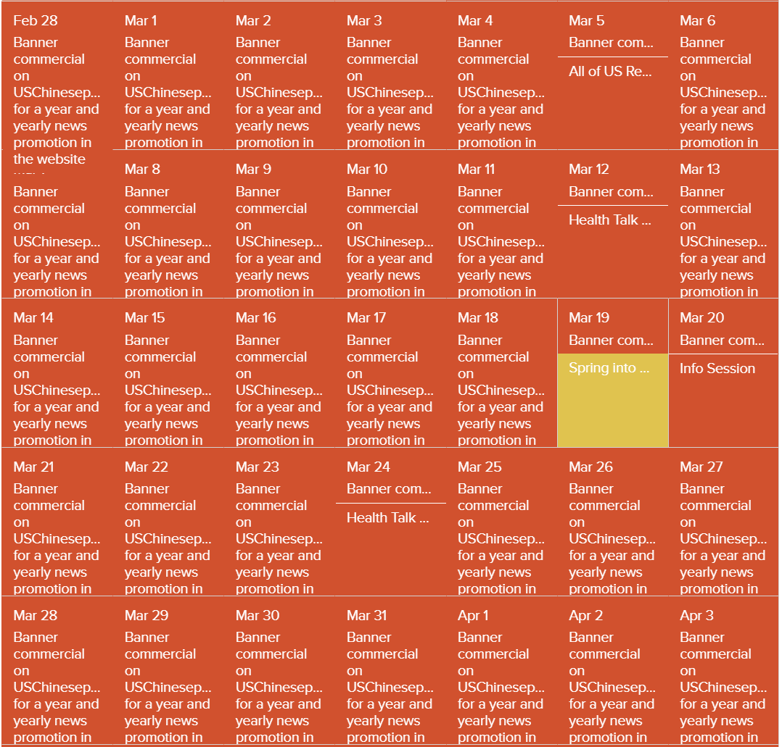
ARC Scheduled Events for March
Total scheduled events: 6
S

Slide 28

Reminder and Closing
Please submit your event reports no later than 30 days after the events
Please don’t forget to submit in-person event reports for all your contactless in-person events
Please submit the Quarterly Report by 3/5
S

